Slide 1
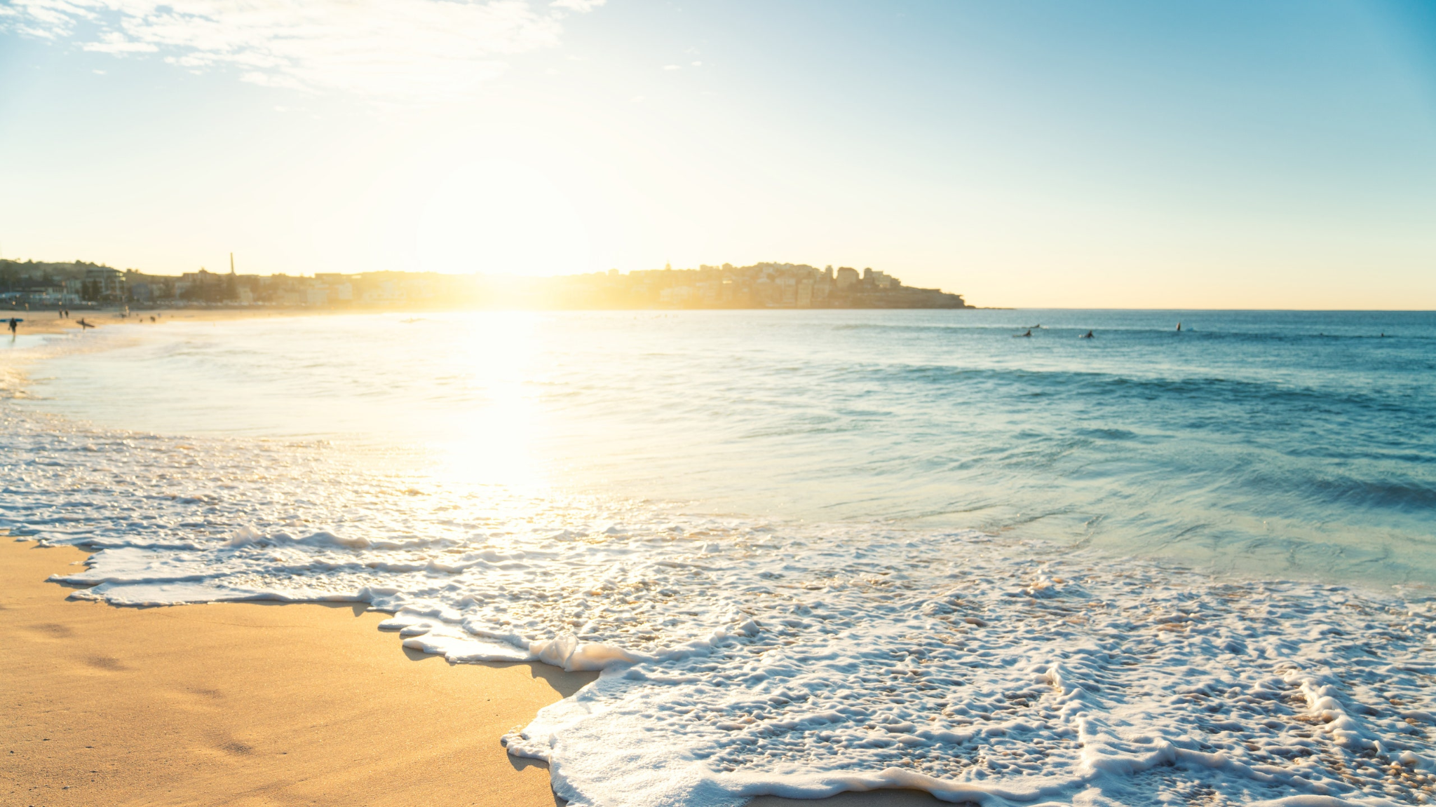
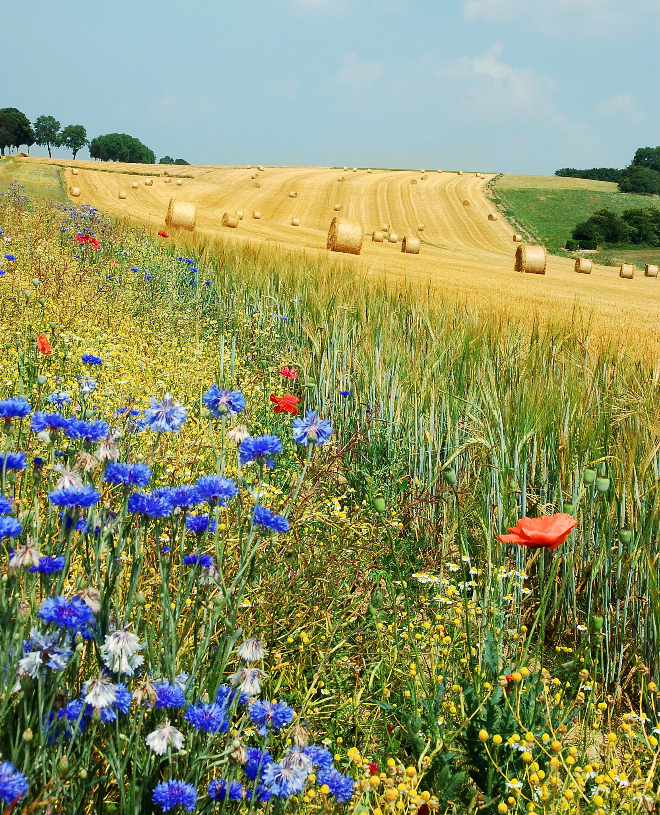
Summer is coming soon
English speaking club

Slide 2
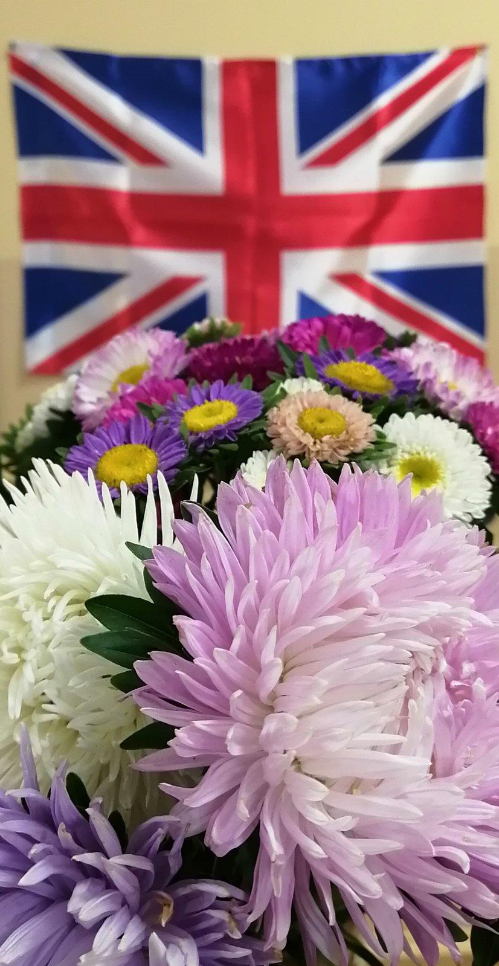
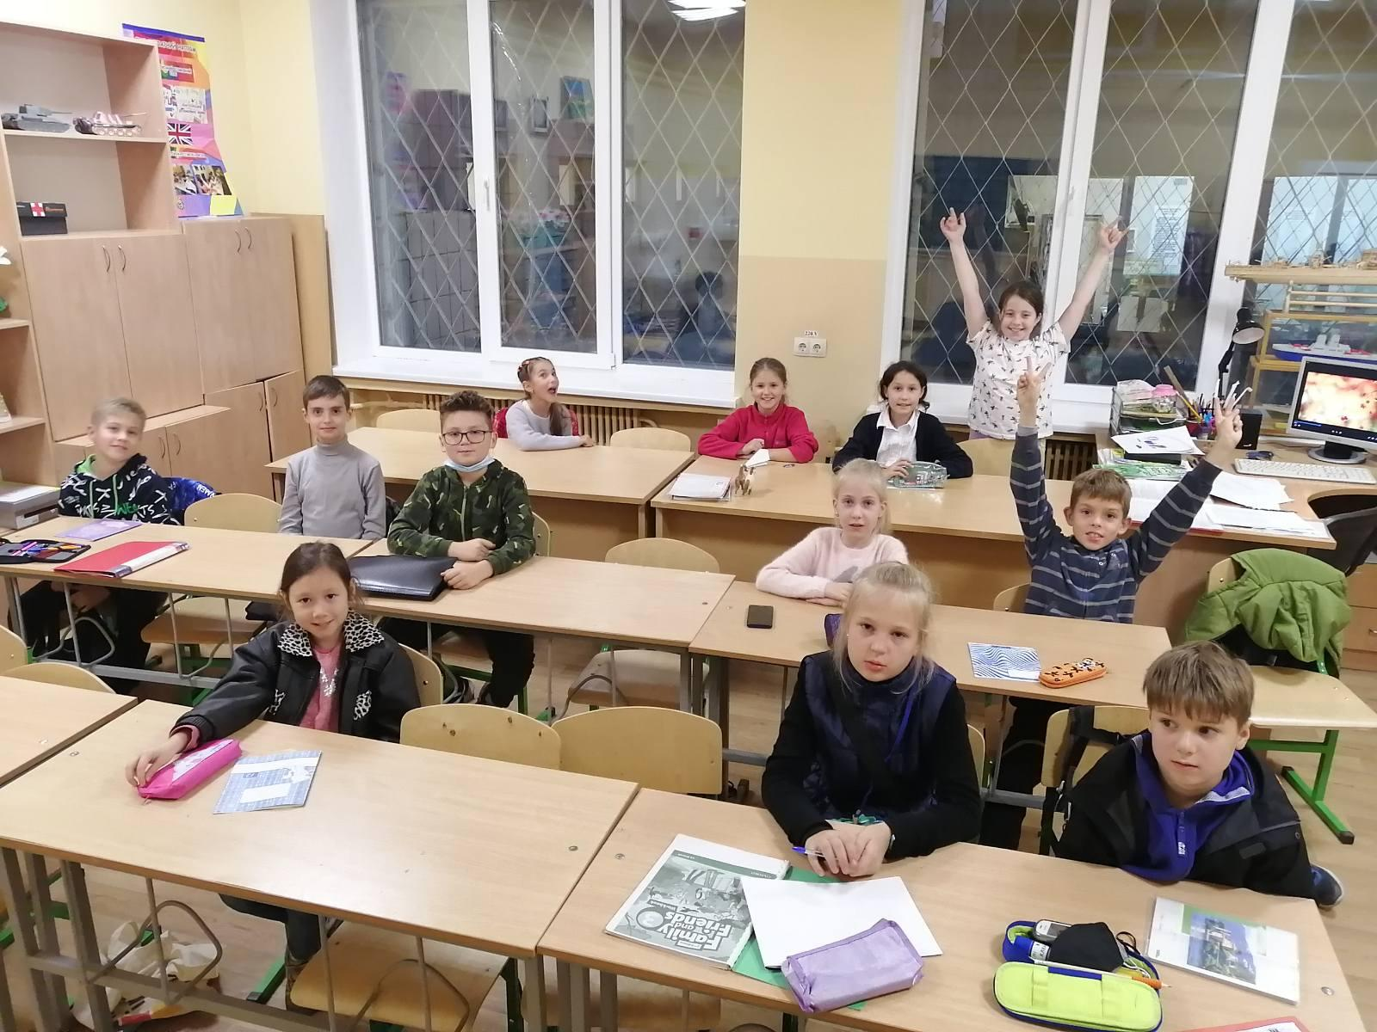
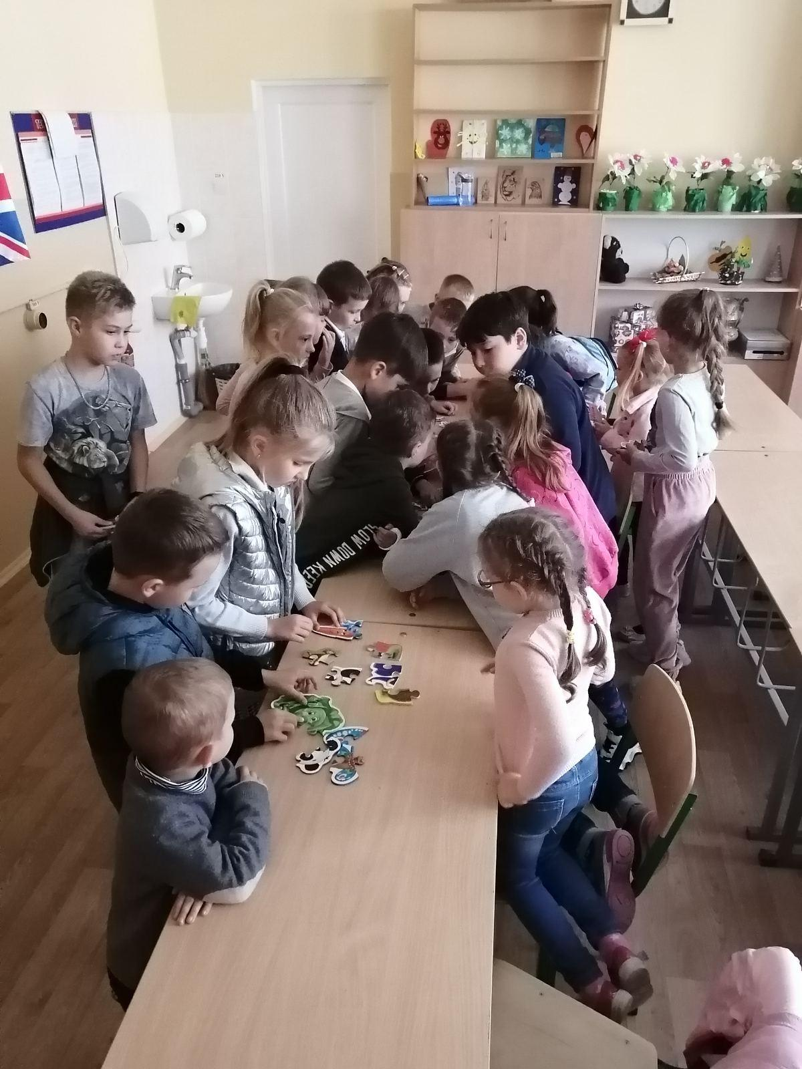
Let's remember how we studied
this year …

Slide 3
We learned to write, count, read ....

Slide 4
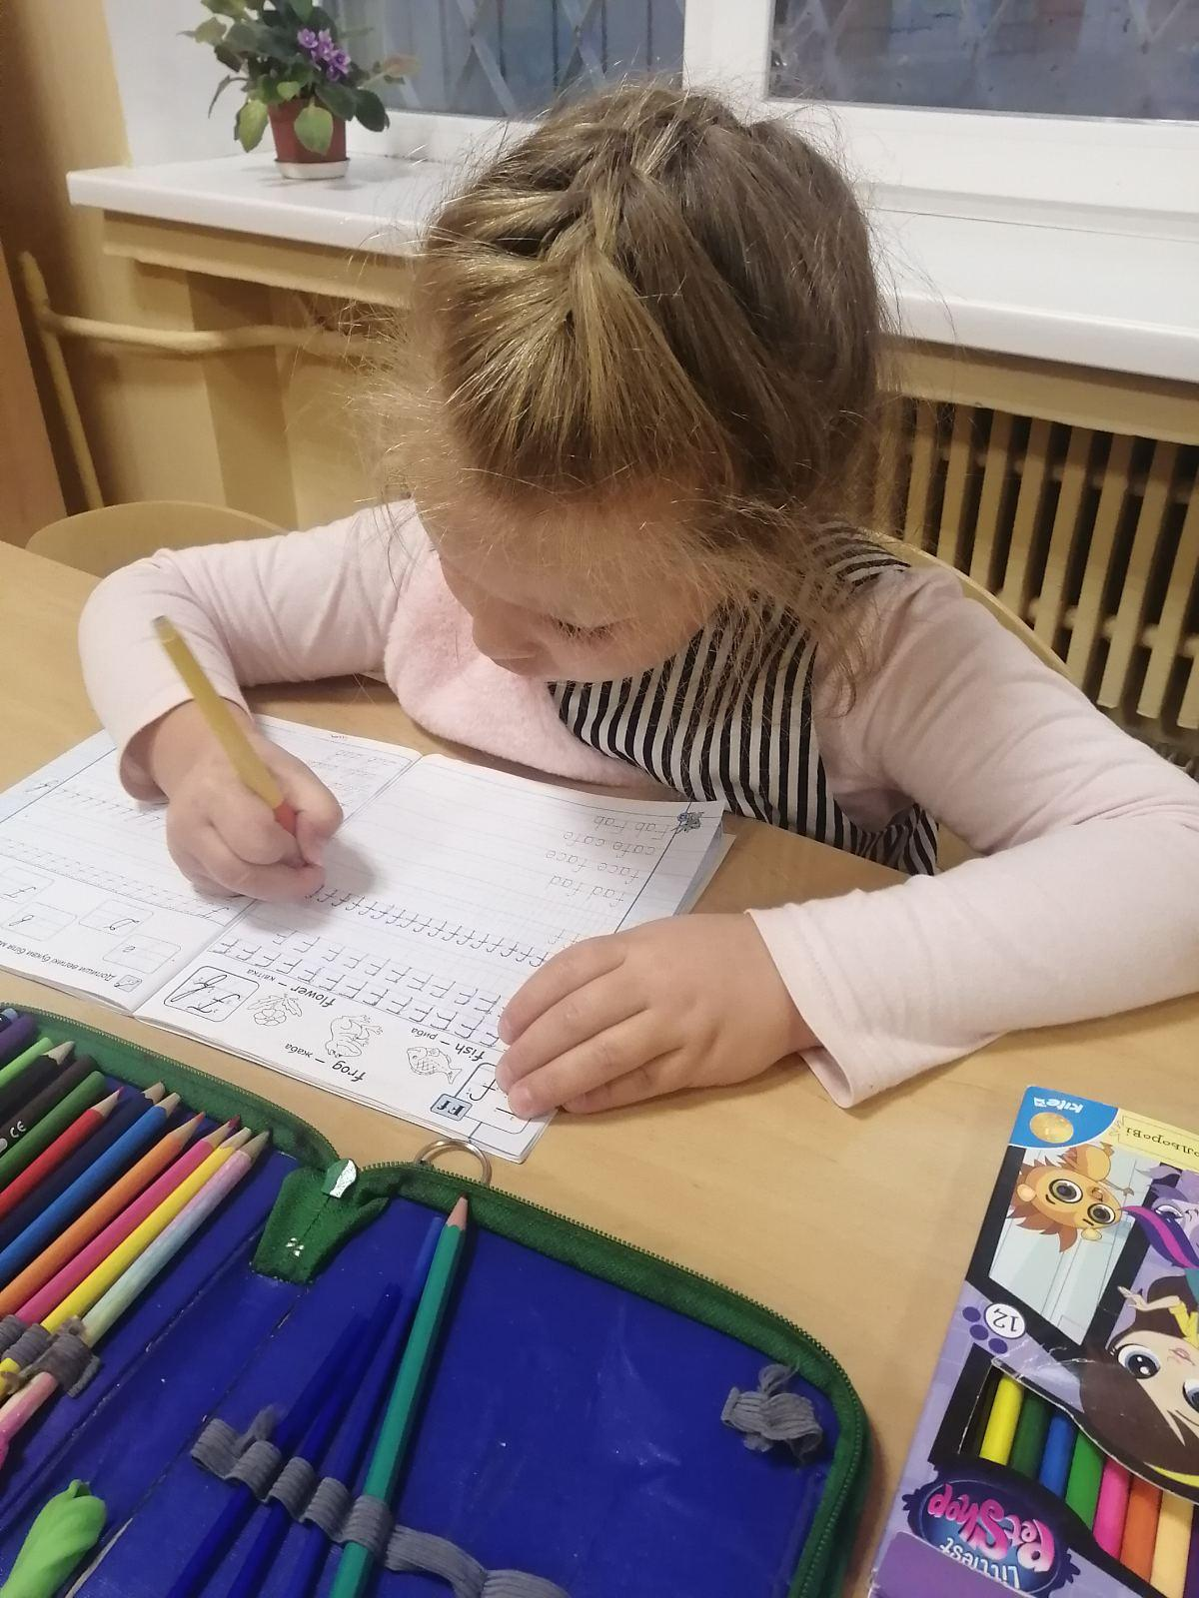
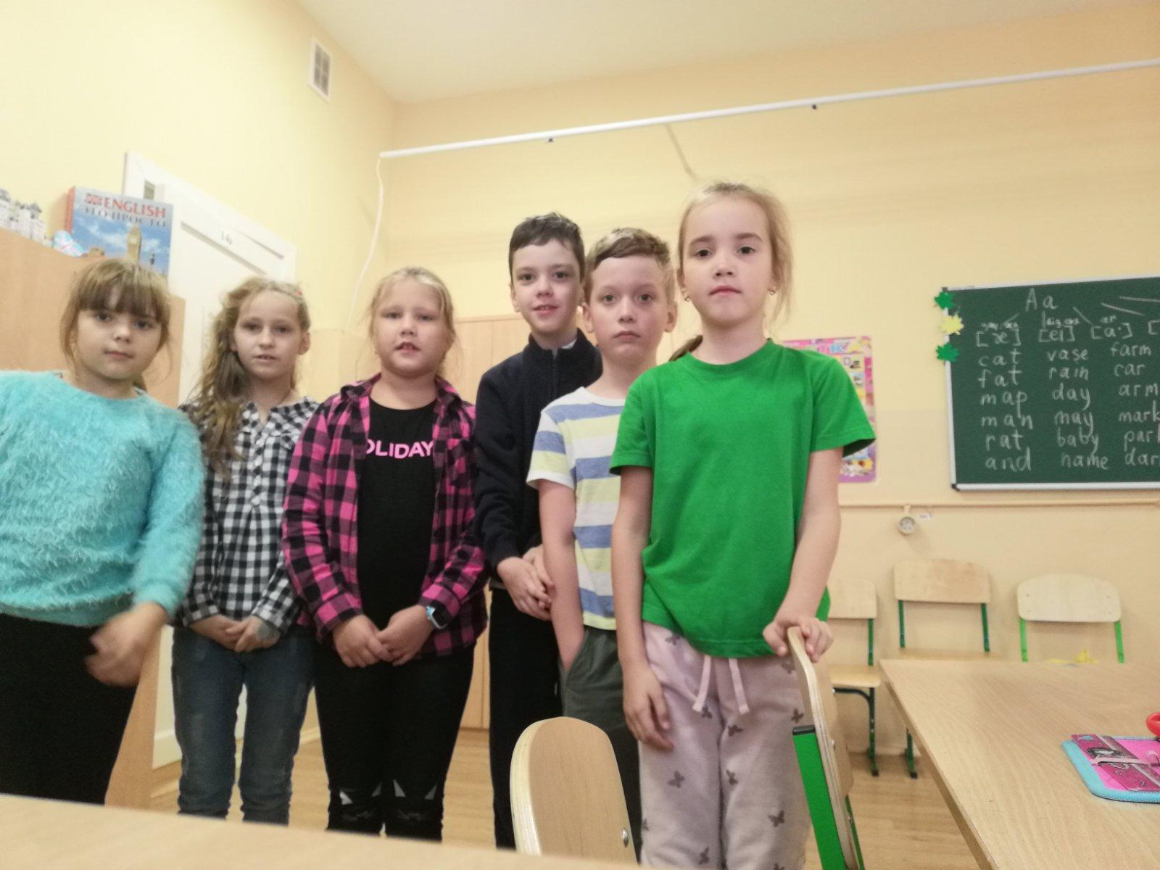
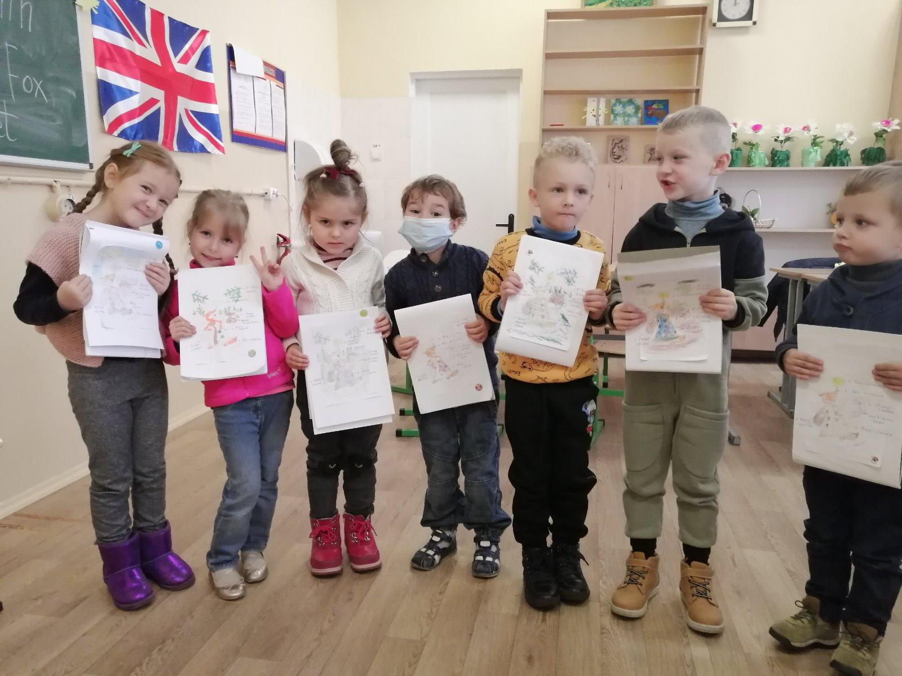
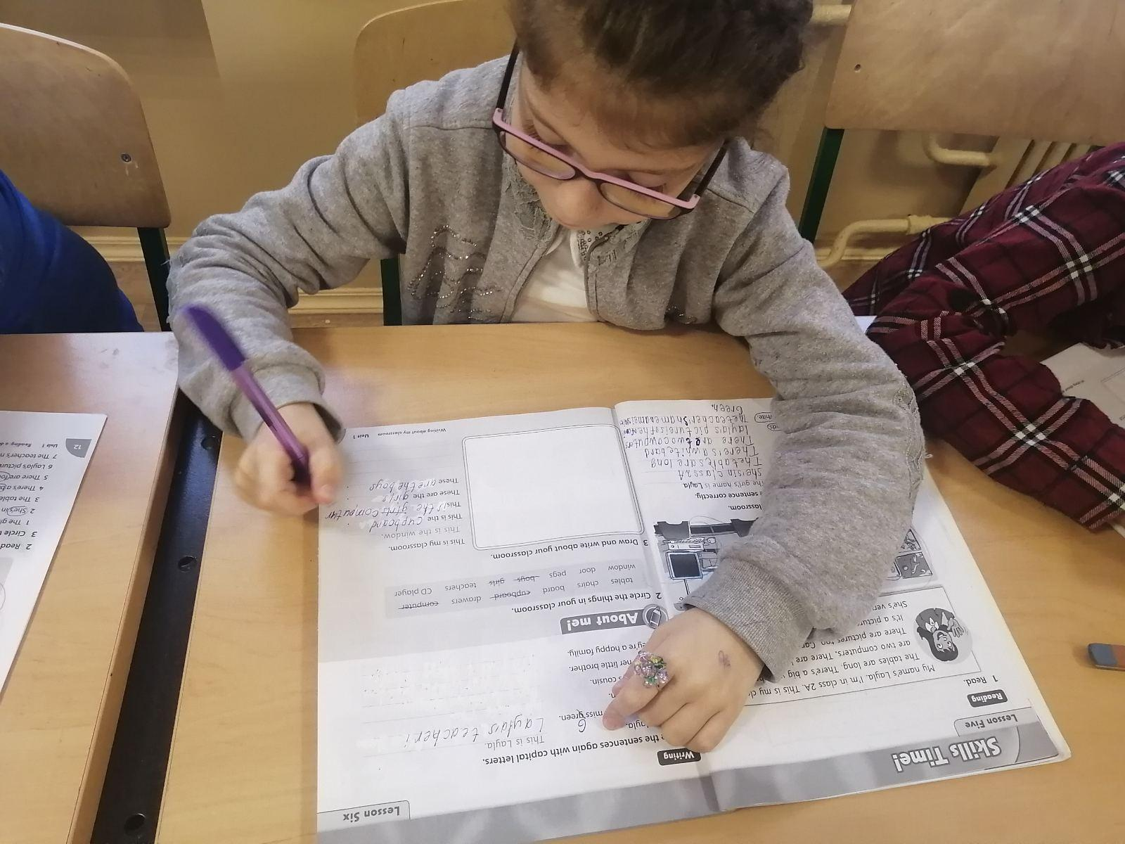
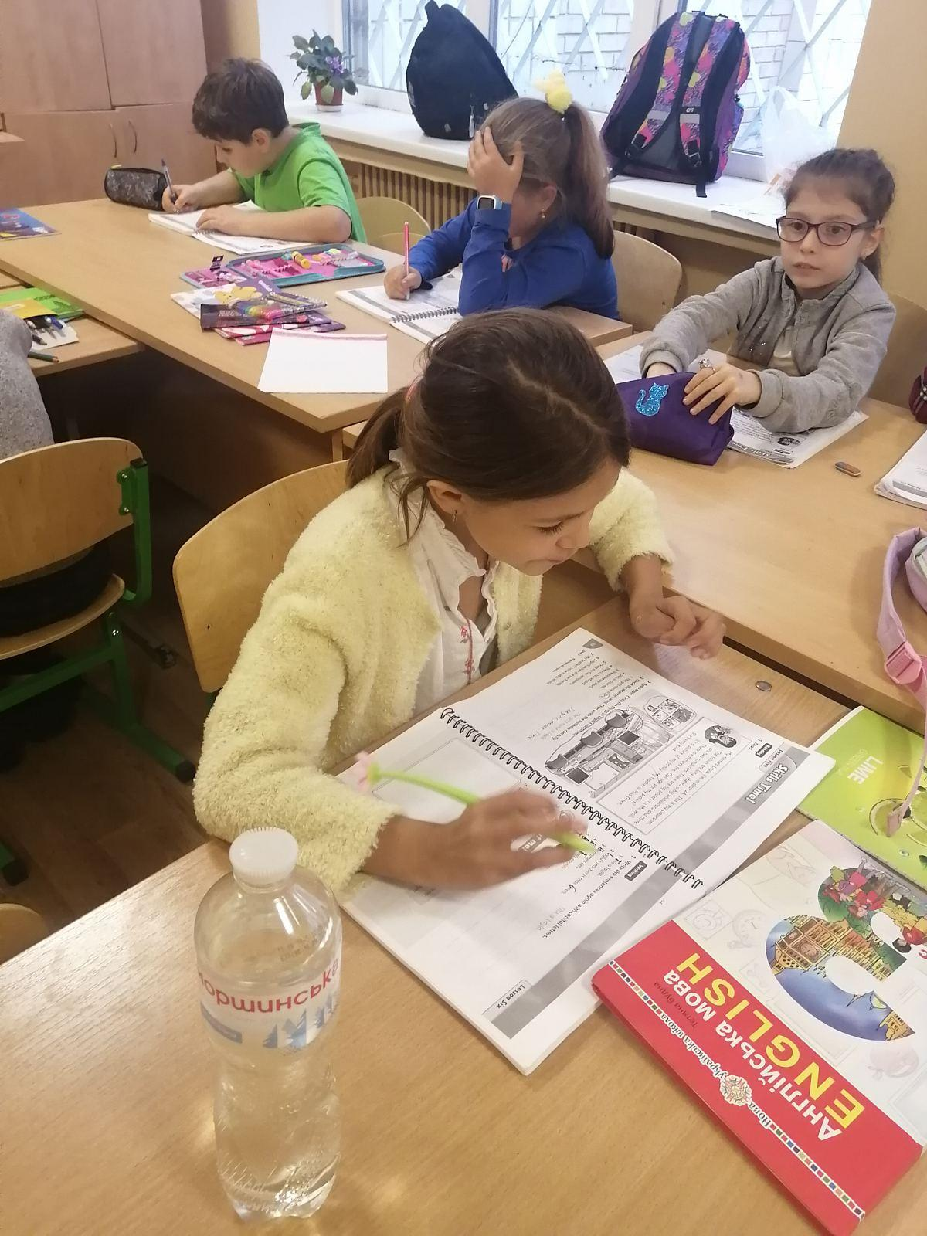

Slide 5
We celebrated holidays, sang songs, played games...

Slide 6
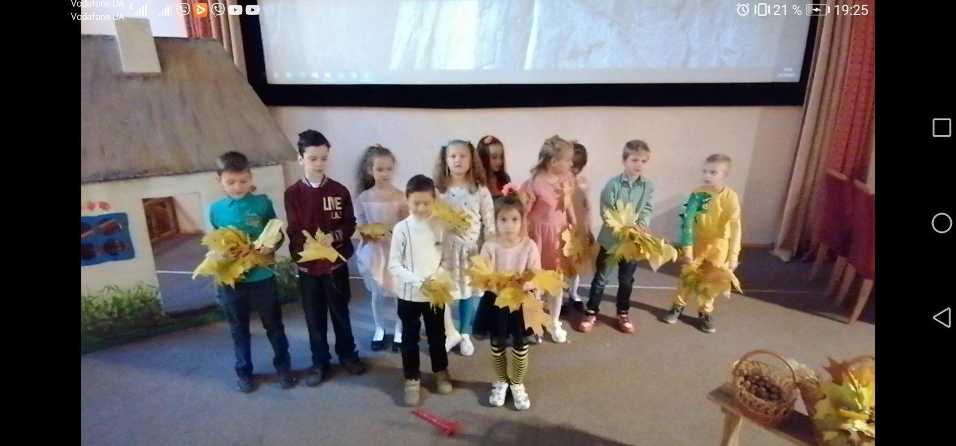
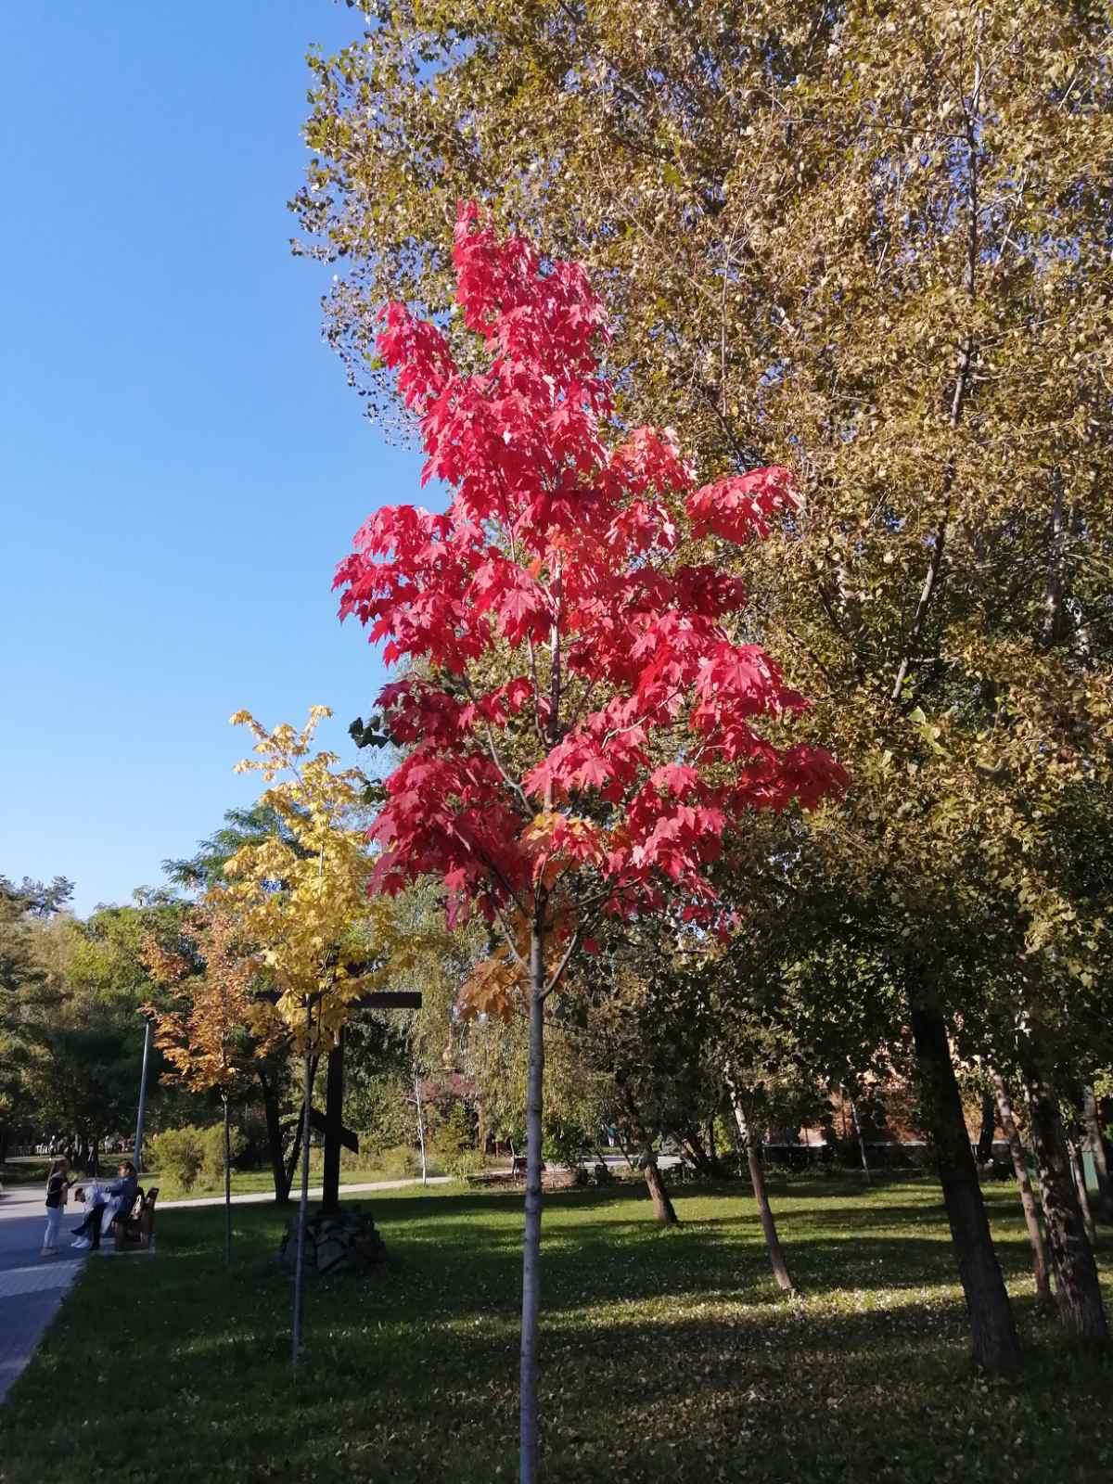
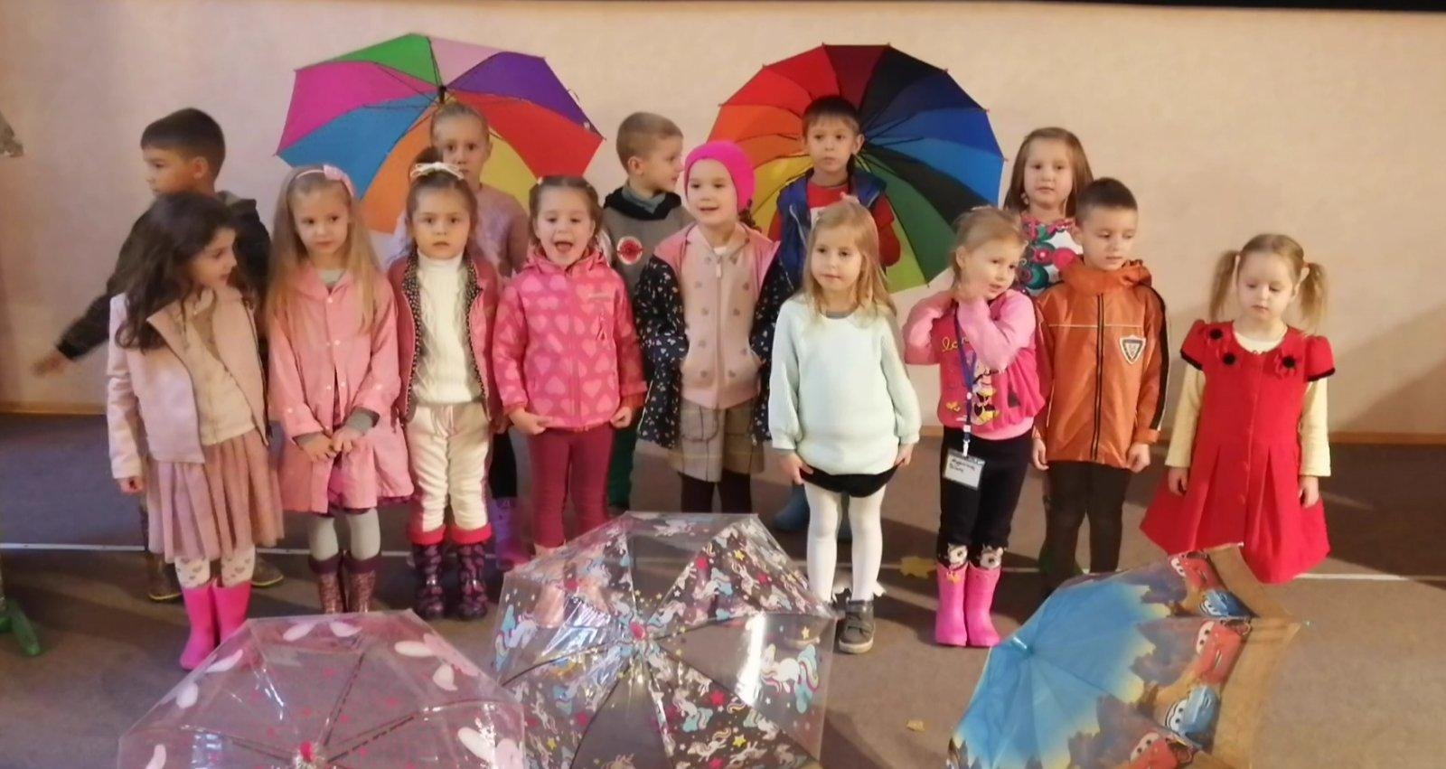
Holiday "Autumn"

Slide 7
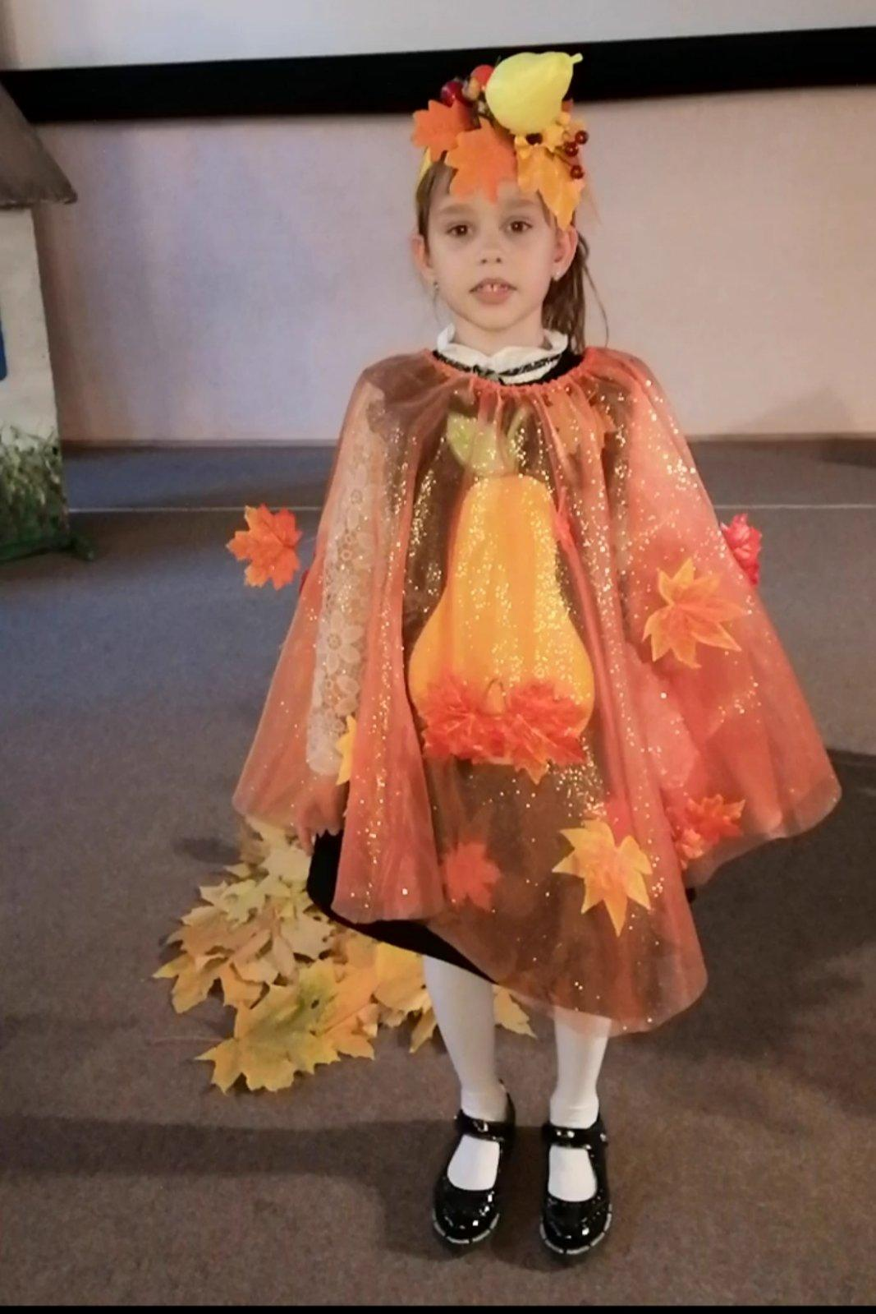
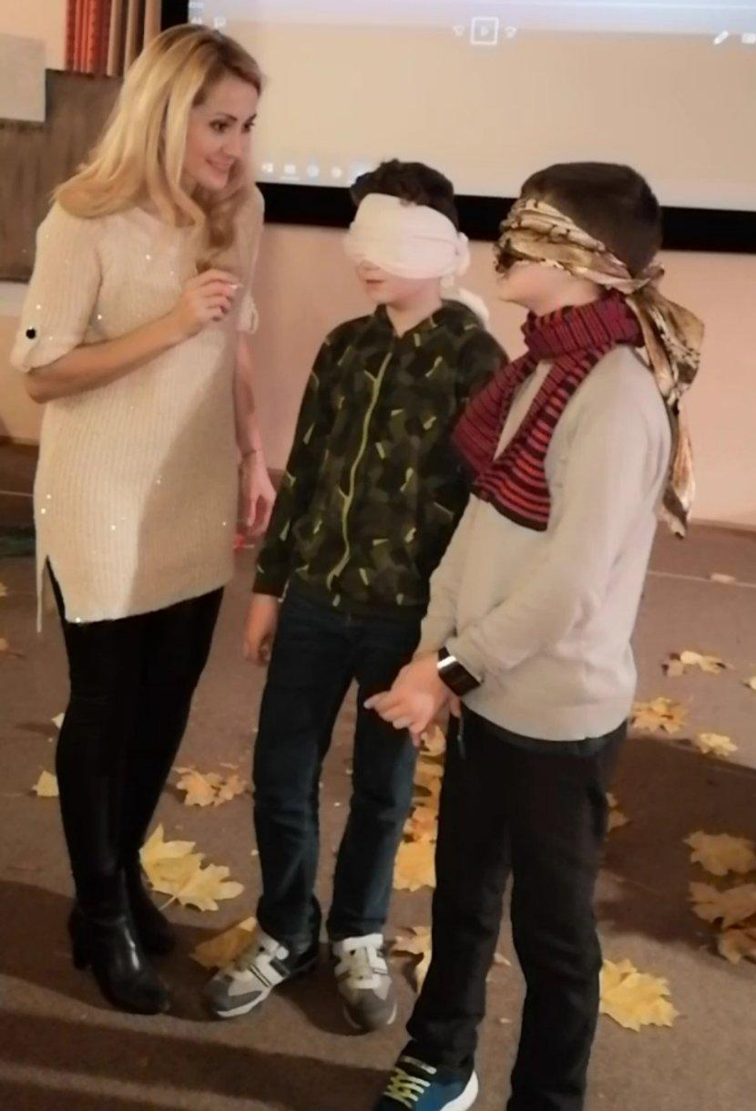
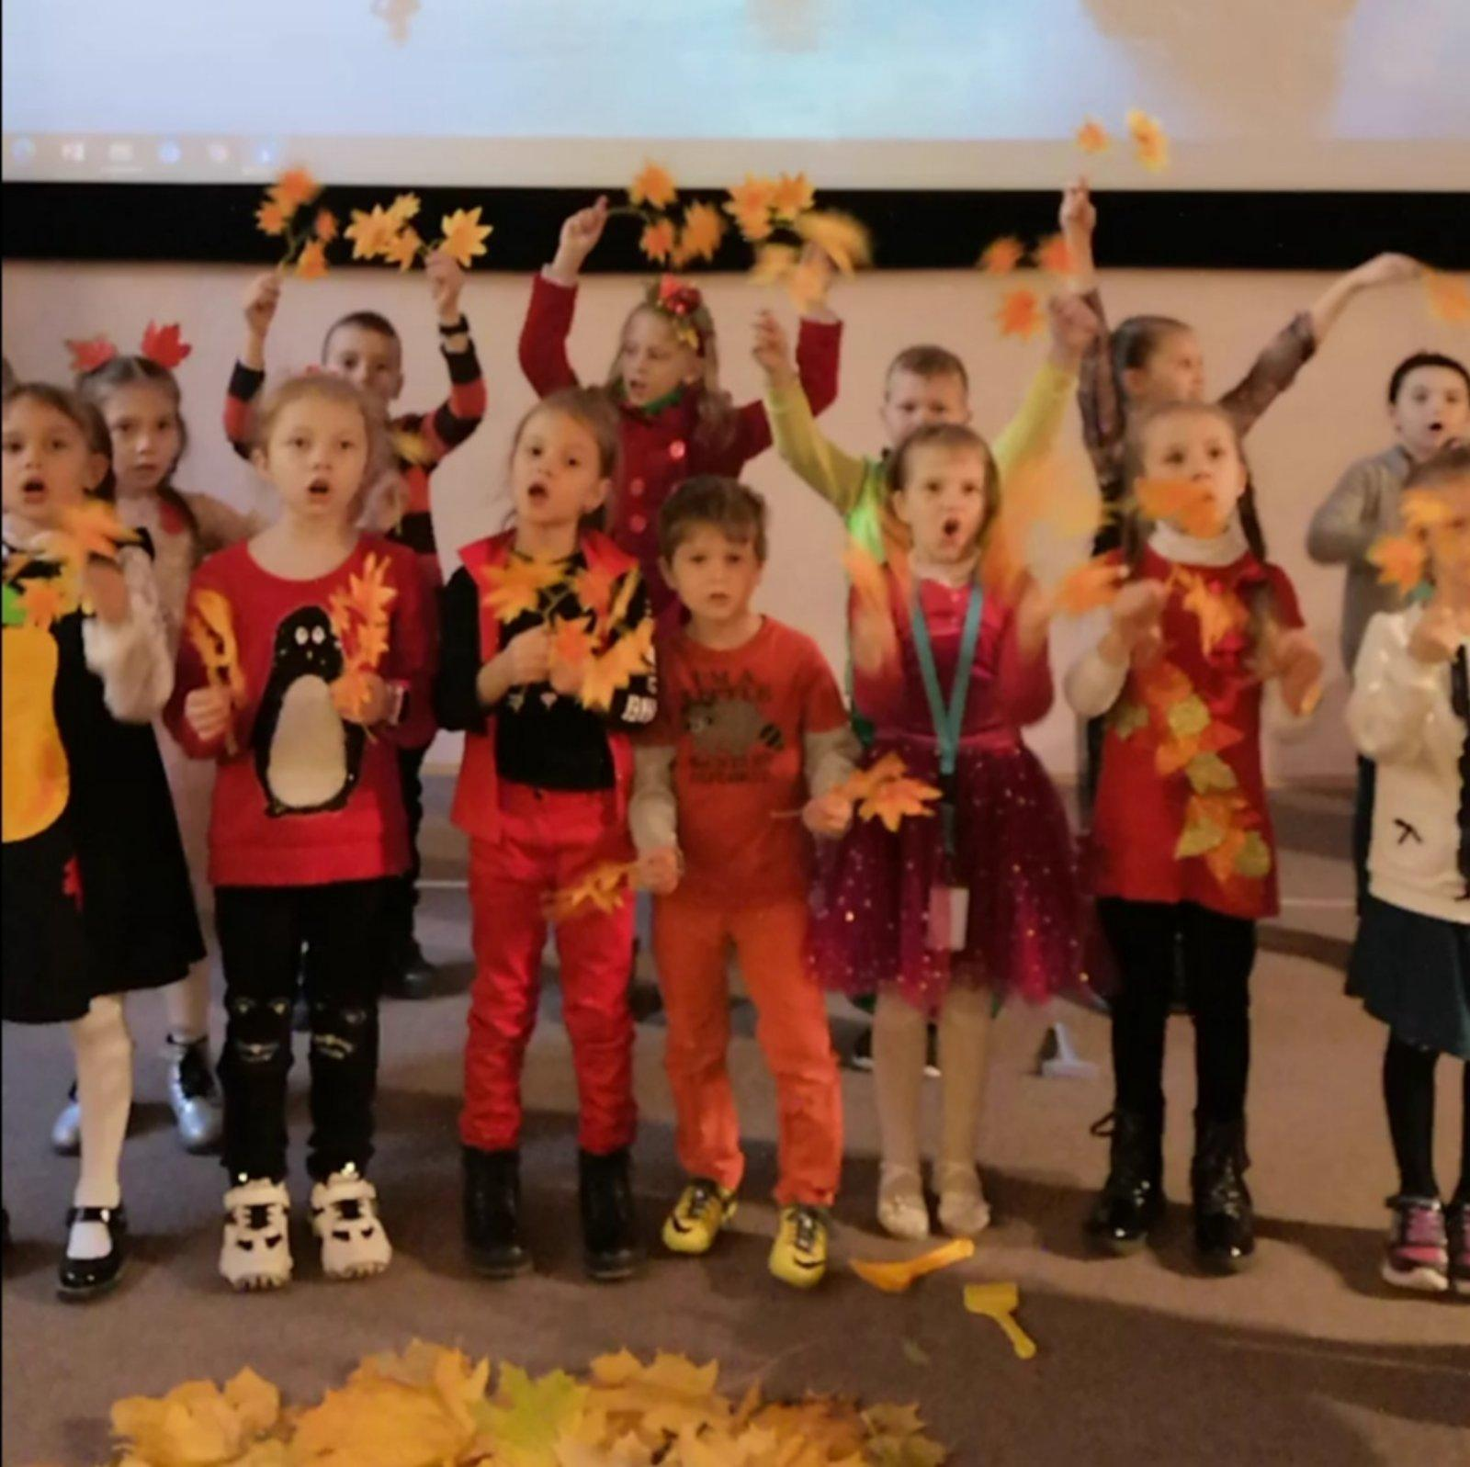
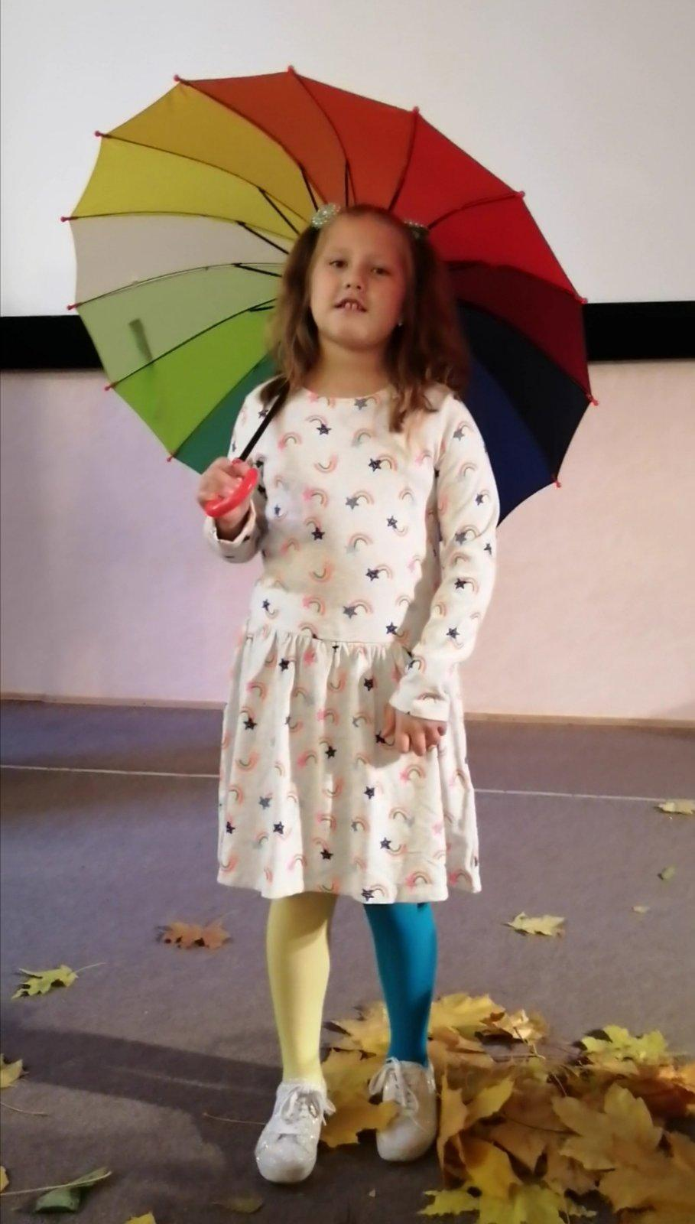

Slide 8
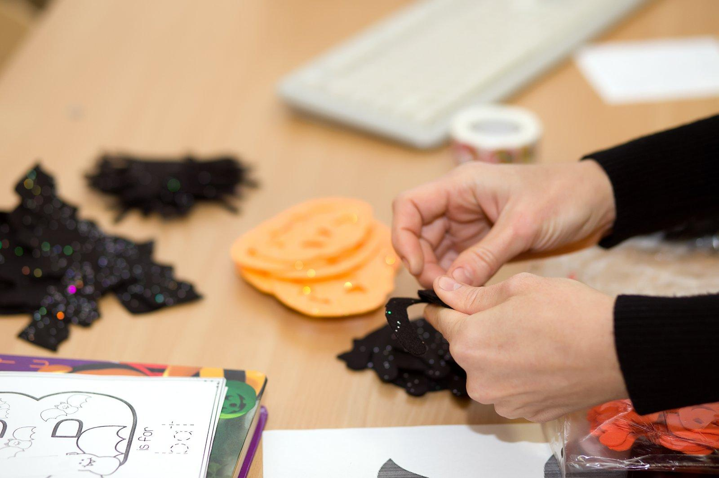
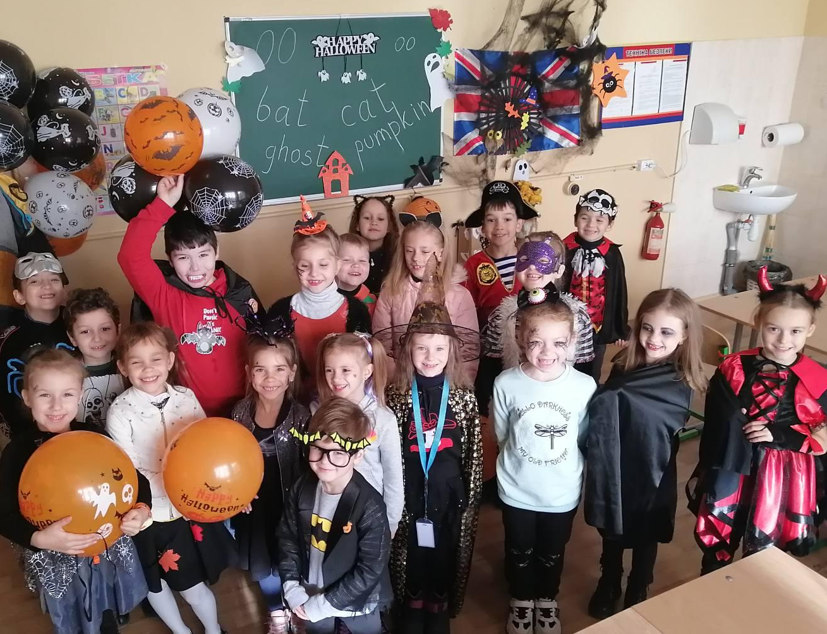
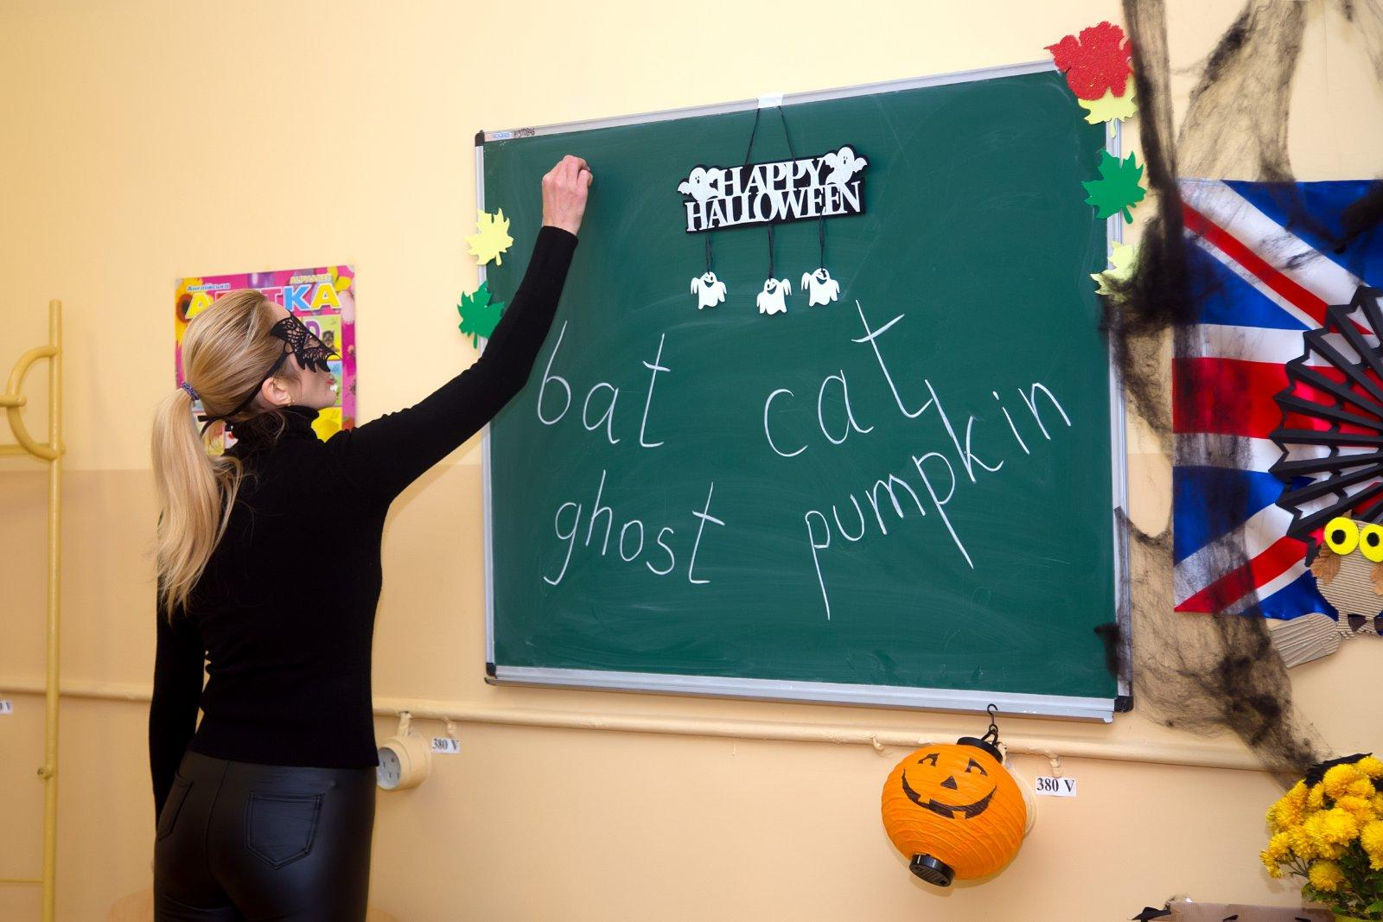
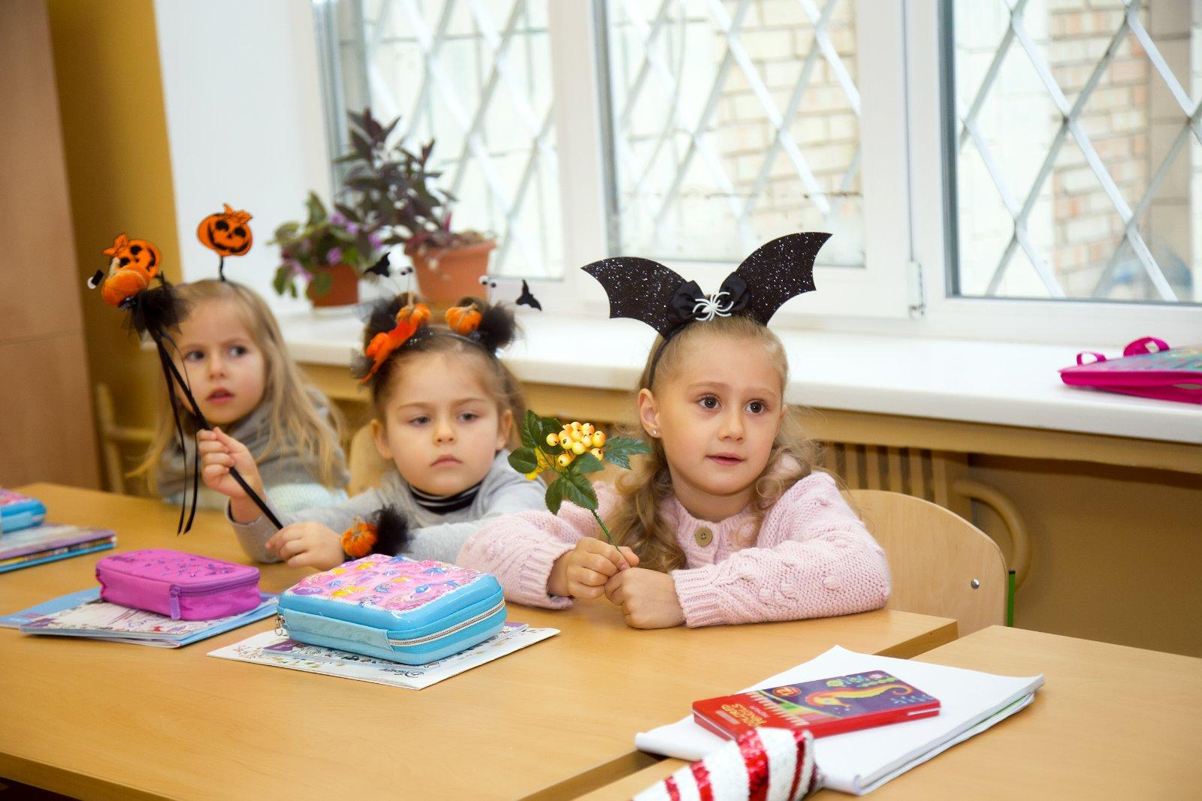
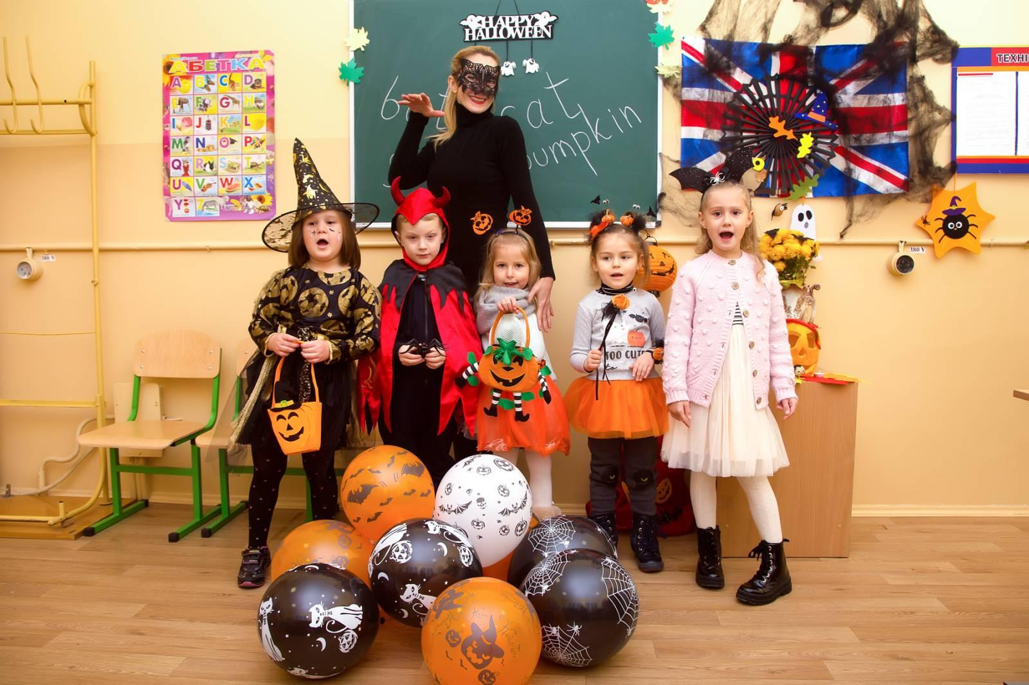
Halloween

Slide 9
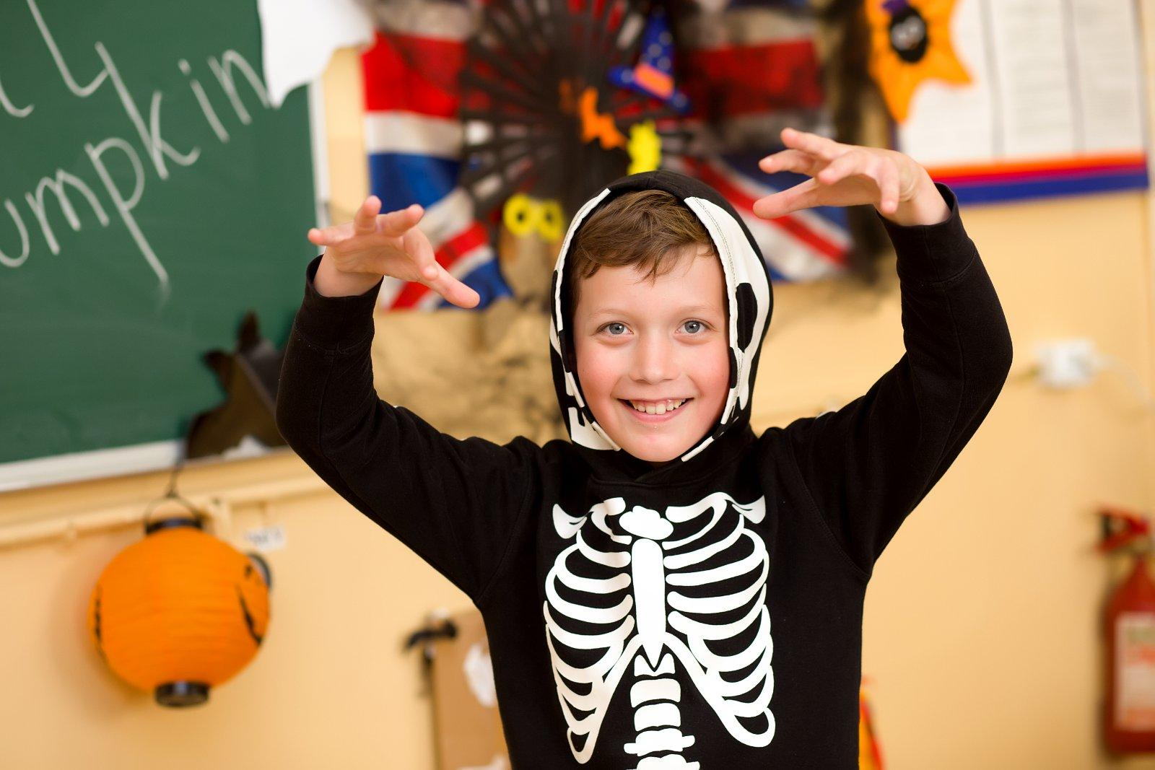

Slide 10
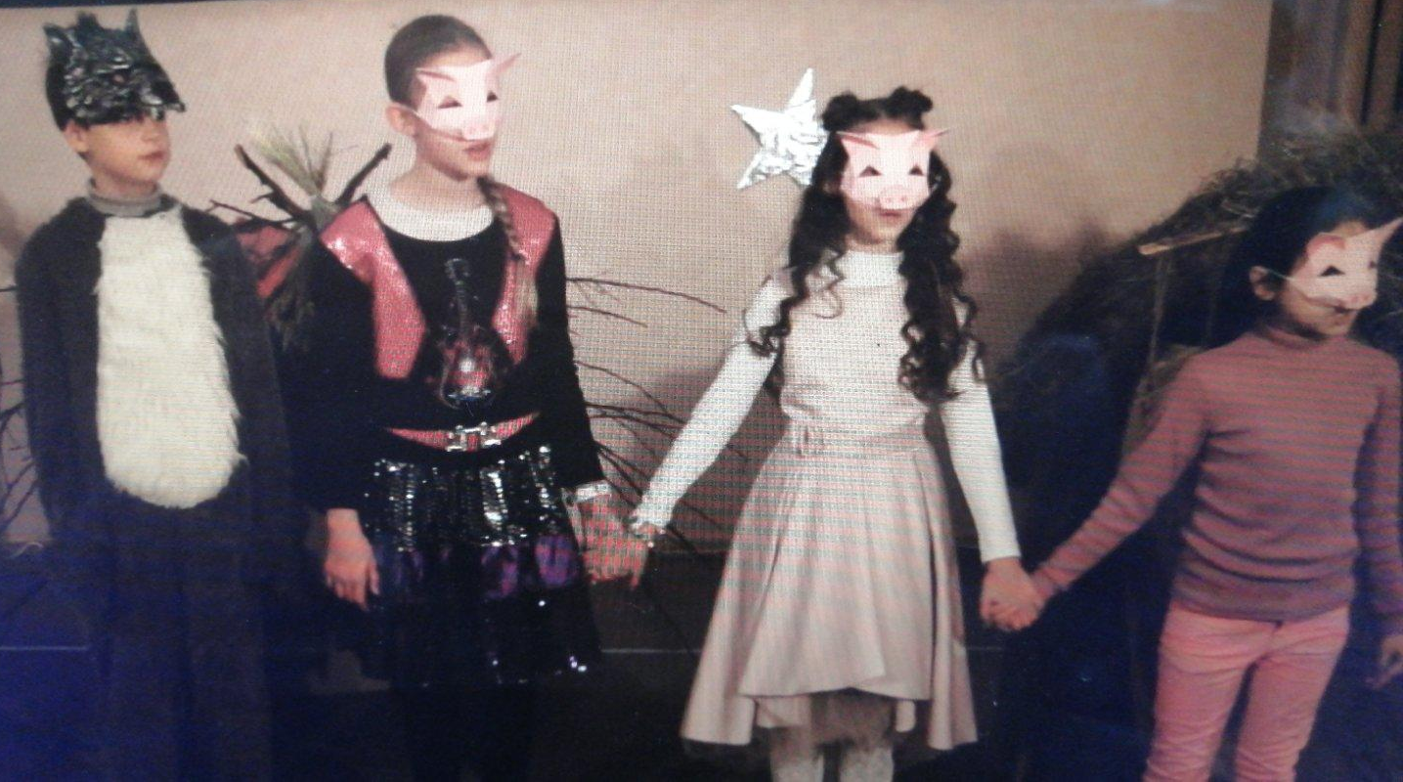
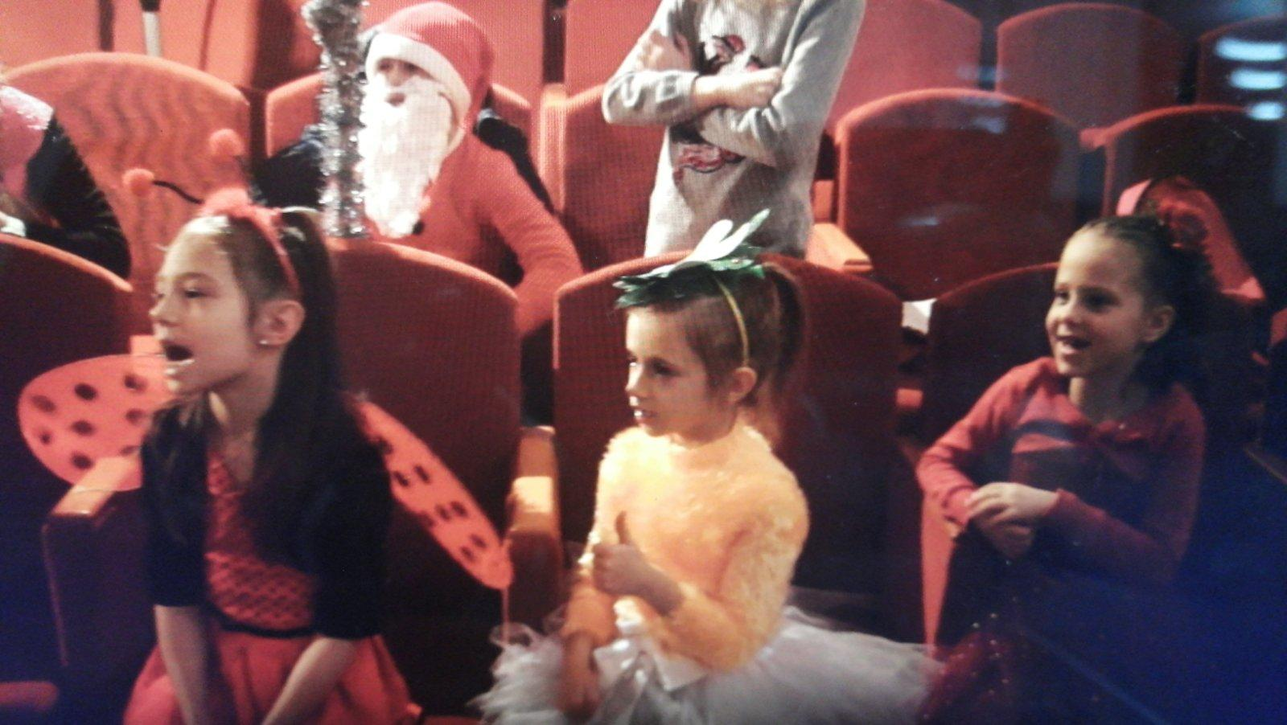
New Year
The children watched the modern New Year's play "Three Little Pigs", played games, sang Christmas carols.

Slide 12
Our lessons were conducted online and offline

Slide 13
Happy Mother`s Day for every mommy!
https://drive.google.com/file/d/1s8J-d4Khq4Qsga1IHP1lTMAxtjEVZVWH/view?usp=sharing

Slide 14
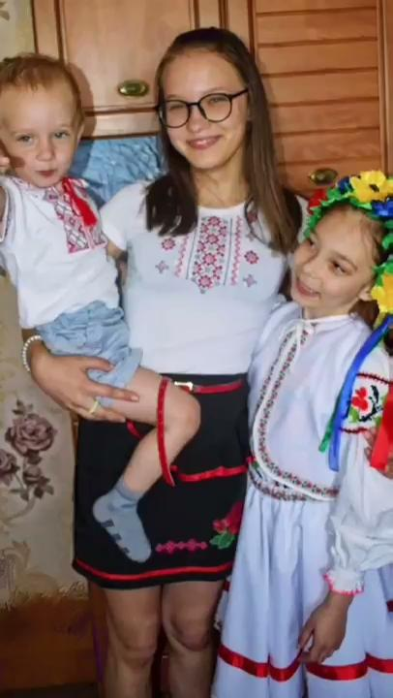
Flashmob “Vyshivanka is your genetic coda”
https://drive.google.com/file/d/1zvt46SHqA4YNyX_GeVOoWGTq3_TZABu-/view?usp=sharing

Slide 15
Happy birthday, Kyiv!!!
https://drive.google.com/file/d/1WnuDL-WmJIt7LbkyORLsdtChXUpGhdTq/view?usp=sharing

Slide 16
Ваші домашні завдання влітку з англійської:
Матеріали представлені у посиланнях на Youtube.
1) Канал з гарними поясненнями граматики - https://www.youtube.com/user/englishstar777/featured
2) Свинка Пеппа для тренування слуху - https://www.youtube.com/c/peppapig
3) Плейлист з відео для тренування говоріння - https://www.youtube.com/playlist?list=PLii5rkhsE0LfAiRdCqhWO17bq-2LIWKVU

Slide 17
See you in the new school year. Happy summer!

